Slide 1
Prometheus + Grafana Monitoring setup POC

Slide 2
What is Prometheus ?

Slide 3
Key Features of Prometheus
Open Source
A multi-dimensional data model with time series data identified by metric name and key/value pairs
PromQL, a flexible query language
Time series collection happens via a pull model over HTTP
Targets are discovered via service discovery or static configuration
Most Prometheus components are written in Go language
Alerting

Slide 4
What is Grafana ?

Slide 5
Key Features of Grafana
Open Source
Grafana supports over 30 open source and commercial data sources
Grafana has many visualization options to help us understand the data very easily
We can mix different data sources in one graph.
Alerting

Slide 6
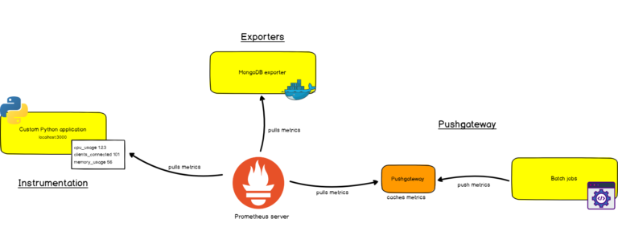
Ways to gather Metrics in Prometheus

Slide 7
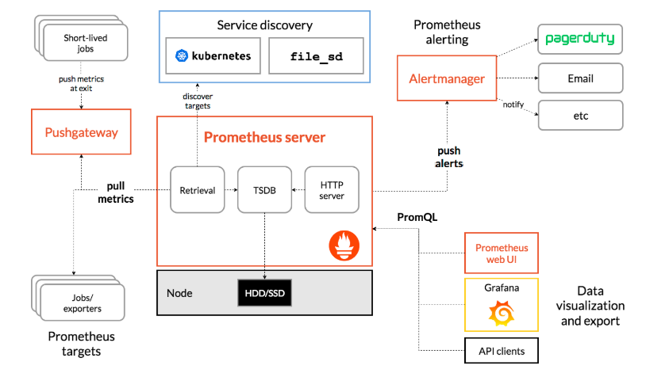
Prometheus Architecture

Slide 8
Problem Statement
In a dynamic environment, where services or instances keep changing every minute - we need a solution by which we can maintain a global list of all services & their addresses
By using the solution, our service can get list of dependent services & addresses which are needed for our service to work as expected
In this case the solution is Service discovery

Slide 9
What is Service discovery ?
Service discovery is how applications and (micro)services locate each other on a network.
Service discovery implementations include both:
a central server (or servers) that maintain a global view of addresses
clients that connect to the central server to update and retrieve addresses.

Slide 10
Prometheus Service Discovery Options
azure_sd_configs: Azure Service Discovery
consul_sd_configs: Consul Service Discovery
dns_sd_configs: DNS Service Discovery
ec2_sd_configs: EC2 Service Discovery
openstack_sd_configs: OpenStack Service Discovery
file_sd_configs: File Service Discovery
gce_sd_configs: GCE Service Discovery
kubernetes_sd_configs: Kubernetes Service Discovery
marathon_sd_configs: Marathon Service Discovery
nerve_sd_configs: AirBnB’s Nerve Service Discovery
serverset_sd_configs: Zookeeper Serverset Service Discovery
triton_sd_configs: Triton Service Discovery

Slide 11
static_configs
scrape_configs:
- job_name: 'prometheus'
static_configs:
- targets: ['1.1.1.1:9100','2.2.2.2:9100']

Slide 12
consul_sd_configs
scrape_configs:
- job_name: 'prometheus'
consul_sd_configs:
- server: 'localhost:8500'

Slide 13
Service Discovery implementation using Consul
Prerequisites:
Consul Server setup (single / cluster)
Prometheus & Grafana installed & configured
Machine image which contains Consul client agent & Node-exporter

Slide 14
Setup
instance-0
----------------------
Node Exporter
Consul Client
poc
----------------------
Prometheus
Grafana
Consul Server
instance-1
----------------------
Node Exporter
Consul Client

Slide 15
Prometheus High Availability

Slide 16
Agenda
Intro to TimeScaleDB
  Pg_prometheus
  Prometheus-postgresql-adapter
Prometheus HA
Demo
Questions

Slide 17
TimeScaleDB
Open source
Enabling long-term storage to Prometheus.
Time-oriented features, API functions, and optimizations.
Based on SQL
https://github.com/timescale/timescaledb

Slide 18
prometheus-postgresql-adapter
With this remote storage adapter, Prometheus can use PostgreSQL as a long-term storage
pg_prometheus is required
https://github.com/timescale/prometheus-postgresql-adapter/

Slide 19
pg_prometheus
Postgresql extension
Translates from PromQL to SQL
https://github.com/timescale/pg_prometheus

Slide 20
Why we need HA for Prometheus
Avoiding data loss
Single point of failure
Avoiding missing alerts
Local storage is limited by single nodes

Slide 21
If we run Multiple Prometheus Instances:
It can be hard to keep data in sync. Often parallel Prometheus instances do not have identical data. scrape intervals may differ, since each instance has its own clock
Remote storage is not available

Slide 22
Adapter leader election
Allow only one instance to write into the Database at any given point of time
Below Lock mechanism has been used to achieve this
Postgresql advisory lock
We can do this with shared mutex (lock) also
Ex: Zookeeper, Consul

Slide 23
Solution
All the data is first collected into Prometheus. Then, Prometheus forwards it to the configured Prometheus PostgreSQL Adapter, which in turn forwards the data towards the database with the pg_prometheus extension and finally TimescaleDB.

Slide 24
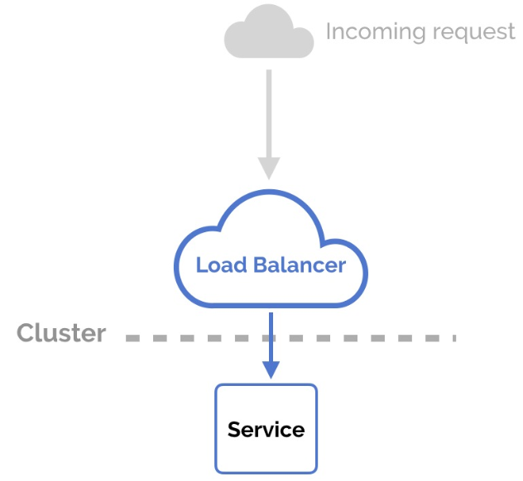
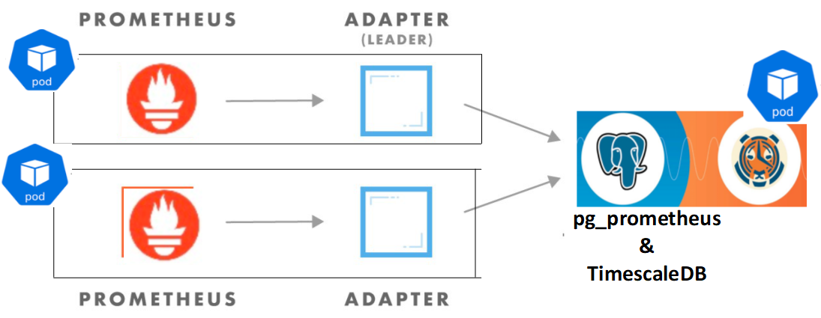
HA Setup Architecture

Slide 25
Demo

Slide 26
Questions

Slide 27
Thanks

